Slide 1
Tutorial 2

Slide 2
Instruction
Based on the data given, prepare ONE slide presentation
Tool: Microsoft Excel
Individual
Link submission will be shared in Spectrum
Discussion during Class session

Slide 3
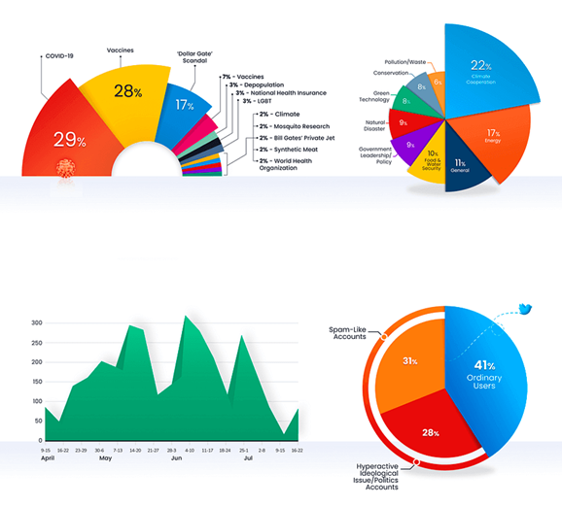
Name
Objective: To identify xx
Data Preparation
Remove x
Remove x
Sample Slide – ONE slide only

